Slide 1
EPSY 5244: Survey Design, Sampling, and Implementation
Wenchao Ma
University of Minnesota

Slide 2
Concepts
A concept is an idea, a general mental formulation summarizing specific occurrences
Objective concepts
Often “observable”
Can be quantified in some objective way
Examples: Age, academic major, years of teaching experience
Notes:
A concept is an idea, a general mental formulation summarizing specific occurrences, such as “gender” representing masculinity and femininity, or “age” summarizing specific instances of the idea of time (youth, middle age, elderly).
A concept can be defined with a dictionary to produce a common usage of the word, and a search of scientific publications can result in a more suitable definition for the appropriate field of study. Otherwise, the meanings of concepts can be quite subjective and made more difficult to measure, especially for more abstract ones.
A good way to start a project, then, is to list the concepts you are interested in studying and then find relevant popular and scientific definitions for them.

Slide 3
Concepts
A concept is an idea, a general mental formulation summarizing specific occurrences
Subjective concepts
Also referred to as “(psychological) constructs”
an underlying, unobservable personal attributes, traits, or characteristics of an individual
a label for a cluster or domain of related behaviors
often assumed to be an underlying cause of a cluster or domain of related behaviors
are hypothetical
Examples: Happiness, love, satisfaction, self esteem, agreeableness
Notes:
A concept is an idea, a general mental formulation summarizing specific occurrences, such as “gender” representing masculinity and femininity, or “age” summarizing specific instances of the idea of time (youth, middle age, elderly).
A concept can be defined with a dictionary to produce a common usage of the word, and a search of scientific publications can result in a more suitable definition for the appropriate field of study. Otherwise, the meanings of concepts can be quite subjective and made more difficult to measure, especially for more abstract ones.
A good way to start a project, then, is to list the concepts you are interested in studying and then find relevant popular and scientific definitions for them.

Slide 4
Concepts must be defined

Slide 5
Concepts
How is “Unemployment” defined?
People are classified as unemployed if they do not have a job, have actively looked for work in the prior 4 weeks, and are currently available for work.
Actively looking for work may consist of any of the following activities:
Contacting an employer directly or having a job interview
Submitting resumes or filling out applications
Placing or answering job advertisements
Checking union or professional registers
Some other means of active job search

Slide 6
Concepts
Passive methods of job search do not have the potential to connect job seekers with potential employers and therefore do not qualify as active job search methods.
Examples of passive methods include attending a job training program or course, or merely reading about job openings that are posted in newspapers or on the Internet.

Slide 7
Concepts
Workers expecting to be recalled from temporary layoff are counted as unemployed whether or not they have engaged in a specific job seeking activity.
In all other cases, the individual must have been engaged in at least one active job search activity in the 4 weeks preceding the interview and be available for work (except for temporary illness).
Source: https://www.bls.gov/cps/cps_htgm.htm#unemployed

Slide 8
Concepts
How do we define “self-esteem?”
Self-esteem is defined as
a positive or negative orientation toward oneself
an overall evaluation of one's worth or value.
People are motivated to have high self-esteem, and having it indicates positive self-regard, not egotism.
Self-esteem is only one component of the self-concept

Slide 9
Concepts
Concepts must be operationalized
To measure unemployment, can we directly ask people if they are unemployed?
To measure self-esteem, can we directly ask people their self-esteem level?

Slide 10
Operationalization of Unemployment
Does anyone in this household have a business or a farm?
Last week, did you do any work for (either) pay (or profit)?
If the answer to question 1 is "yes" and the answer to question 2 is "no," the next question is:
Last week, did you do any unpaid work in the family business or farm?
For those who reply "no" to both questions 2 and 3, the next key questions used to determine employment status are:
Last week, (in addition to the business) did you have a job, either full or part time? Include any job from which you were temporarily absent.
…
Source: https://www.bls.gov/cps/cps_htgm.htm#unemployed

Slide 11
Operationalization of Self-Esteem
https://wwnorton.com/college/psych/psychsci/media/rosenberg.htm

Slide 12
Measurement
Assignment of numerals to objects or events according to rules
When measuring construct, one assigns numbers to individuals
The number assigned represents the level of the construct for the individual
Four levels
Nominal
Ordinal
Interval
Ratio

Slide 13
Measurement - Nominal
Different numbers represent distinguish different categories
Numbers do not have any real numerical meaning
It is not appropriate to add, subtract, or otherwise manipulate them numerically.

Slide 14
Measurement - Ordinal
Numbers represent a rank order of the properties of objects
Although the numbers used in ordinal measurement imply rank order, the intervals between adjacent scale points are not assumed to be equal
Ordinal measures can be transformed in any way that preserves the original order

Slide 15
Measurement - Interval
No true zero
Appropriate to calculate nearly all parametric statistics, such as the mean, standard deviation, and correlation from interval level data
Notes:
A common example of interval level measurement
is temperature as measured by the
Fahrenheit or Centigrade scales, in which
the difference in heat between scale points
of 50° and 51° is the same as the difference
between 90° and 91°.

Slide 16
Measurement - Ratio
Distinctiveness, order, equal intervals and true zero point
A true zero point is one that represents the absolute lack of the property being measured

Slide 17
What measurement scale are “Unemployment” and “Self-Esteem” on?

Slide 18
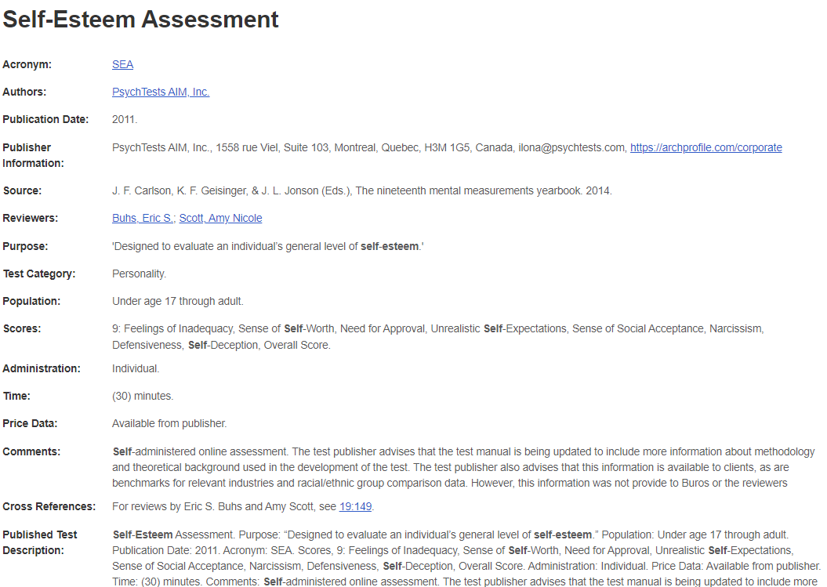
Where can you find psychological tests?
Mental measurements yearbook (MMY) can be accessed from UofM library.

